Slide 1

WATER QUALITY PREDICTION SYSTEM
(IV CSE B)
NITISH KUMAR D P | - | 610519104072
NARESH KUMAR D | - | 610519104069
MOHAN R | - | 610519104063
NANDAMUDI DINESH | - | 610519104067
FINAL REVIEW
UNDER THE GUIDANCE OF
Ms.N.RADHA,
ASSISTANT PROFESSOR,
DEPARTMENT OF COMPUTER SCIENCE AND ENGINEERING,
DHIRAJLAL GANDHI COLLEGE OF TECHNOLOGY ,SALEM

Slide 2
AGENDA
Introduction
Abstract
Literature Survey
Existing System
Proposed System
Workflow
Requirements
Modules
Results
Conclusion
Future Enhancements
Reference

Slide 3
INTRODUCTION
Water Quality prediction System designed to provide accurate and timely information on water quality
Uses IoT and machine learning algorithms to analyze various parameters such as pH, Hardness, Solids, Chloramines, Sulfate, Conductivity, Organic Carbon, Trihalomethanes, Turbidity to determine overall quality of water
Provides real-time predictions and to help users make informed decisions about water usage and management practices.
Essential tool for government agencies, water utilities, and communities that depend on safe and reliable water resources.

Slide 4
INTRODUCTION TO MACHINE LEARNING
Machine learning is a branch of artificial intelligence (AI) and computer science.
It focuses on using data and algorithms to imitate the way that humans learn.
Machine learning gradually improves its accuracy over time.
Machine learning is used in various applications, such as internet search engines, email filters, personalized recommendations on websites, banking software to detect unusual transactions, and voice recognition on mobile apps.

Slide 5
INTRODUCTION TO INTERNET OF THINGS
IoT is a network of physical devices, buildings, and objects with sensors, software, and connectivity.
It enables the exchange of data and interaction between devices and objects.
IoT technology is used in various applications such as smart homes, healthcare, transportation, and manufacturing.
The potential impact of IoT is significant, including creating a more efficient, productive, and sustainable world.
The number of connected devices in IoT is growing rapidly, with billions of devices already connected.

Slide 6
ABSTRACT
The goal is to predict water quality using machine learning and IoT.
Traditional water quality monitoring methods can be time-consuming, expensive.
The machine learning-based approach uses supervised learning algorithms to predict water quality based on various factors.
The factors include pH levels, solids, hardness, sulphates, chloramines, trihalomethanes, organic carbon, conductivity, temperature, and turbidity.
The supervised learning algorithms used are random forests, Extreme Gradient Boosting, and support vector machines and support vector classifier.
The model will be trained on a dataset of water quality measurements and tested on a separate dataset to evaluate its accuracy.
The project aims to improve water quality management and ensure the safe and efficient use of water resources

Slide 7
LITERATURE SURVEY
TITLE: Water Quality Classification Using SVM And XGBoost Method (2022)
AUTHORS: Hasriq Izzuan Hasnol Yusri, A’zraa Afhzan Ab Rahim, Siti Lailatul Mohd Hassan, Ili Shairah Abdul Halim, Noor Ezan Abdullah
A research study developed a classification algorithm using Support Vector Machine (SVM) and Extreme Gradient Boosting (XGBoost) to predict water quality classification (WQC) based on the water quality index (WQI) and seven parameters.
The results showed that the XGBoost model achieved a higher accuracy of 84% compared to the SVM model, which had an accuracy of only 67%.
Based on these findings, XGBoost was concluded to be superior for water quality classification due to its enhanced performance.

Slide 8
LITERATURE SURVEY
TITLE: Interpretable tree-based ensemble model for predicting beach water quality AUTHORS: L. Li et al
To address this, researchers evaluated five tree-based models: classification tree, random forest, CatBoost, XGBoost, and LightGBM.
They employed the SHAP (SHapley Additive exPlanations) explanation method to interpret the models.
Local SHAP values further supported the importance of lake turbidity, showing a nearly monotonic relationship with its value and minimal influence from other factors.

Slide 9
LITERATURE SURVEY
TITLE: Prediction of groundwater quality using efficient machine learning technique(2021)
AUTHORS: Lingbo Li, Jundong Qiao, Guan Yu, Leizhi Wang, Hong-Yi Li, Chen Liao, Zhenduo Zhu
A study was conducted to predict groundwater quality using different machine learning models.
The models compared were random forest (RF), eXtreme gradient boosting (XGBoost), artificial neural network (ANN), and a deep learning (DL) model.
Various physicochemical parameters were measured to compute an entropy weight-based groundwater quality index (EWQI).

Slide 10
EXISTING SYSTEM
Water quality is important for determining if water is safe for consumption.
Water Quality Index (WQI) is used to classify water safety.
Machine learning algorithms, SVM and XGBoost, can predict water quality using available parameters.
Parameters used for classification include: dissolved oxygen, pH, conductivity, biological oxygen demand, nitrate, fecal coliform, and total coliform.
Future research can improve water quality classification by using more parameters or advanced deep learning algorithms.

Slide 11
KEY ISSUES IN PREVIOUS SYSTEM
Insufficient or incomplete data on water quality parameters can hinder the accuracy of the predictive models. Missing data or gaps in the dataset may lead to biased predictions.
The availability of real-time data is crucial for accurate predictions. In many cases, water quality data is collected infrequently, resulting in outdated models that may not reflect the current conditions.
Choosing the right set of features (input variables) is essential for accurate predictions. If irrelevant or redundant features are included, it can introduce noise and impact the model's performance.

Slide 12
PROPOSED METHODOLOGY
The proposed system uses XG Boost, Random Forest, Support Vector Machine(SVM), Support Vector Classifier(SVC) algorithms for water quality prediction.
The parameters taken for Water Quality Prediction using Machine Learning are pH, Hardness, Solids, Chloramines, Sulfate, Conductivity, Organic Carbon, Trihalomethanes, Turbidity
A Web Application is Developed to check the water quality.
Then for Real time Detection of water parameters IoT Sensors are being used

Slide 13
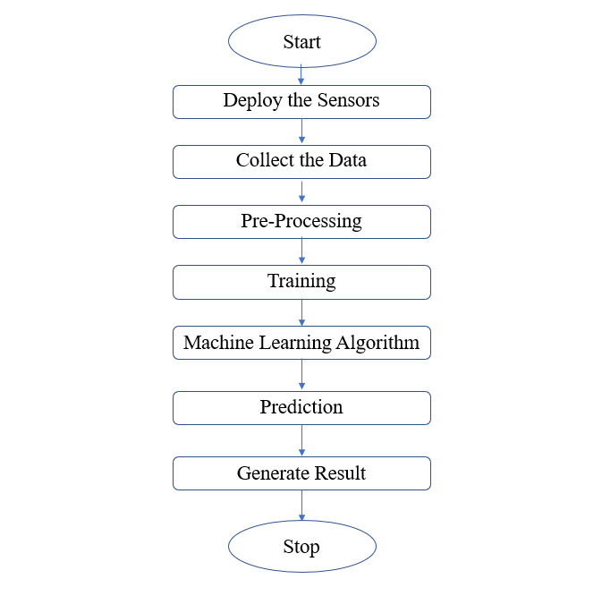
WORK FLOW

Slide 14
REQUIREMENTS SPECIFICATION
SOFTWARE REQUIREMENTS |  |  | HARDWARE REQUIREMENTS
Operating System | : | Windows OS | pH Sensor
Programming Language | : | Python, C | Temperature Sensor
Installation Software | : | Python | Turbidity Sensor
Platform | : | Visual Studio Code | Arduino UNO
 |  |  | ESP32866 Microcontroller
 |  |  | 16*2 LCD Display

Slide 15
MODULES SPLIT UP
Sensor module: This module is responsible for collecting data from various water quality sensors such as pH, temperature, turbidity, etc. The collected data is then transmitted to the central system through wireless communication protocols like Wi-Fi or LoRa.
Data acquisition and transmission module: This module is responsible for collecting the data from the sensor module and transmitting it to the central system. It may include microcontrollers, wireless communication protocols, and other hardware components.
Data storage and management module: This module is responsible for storing the collected data, which can be accessed by the machine learning module for analysis and prediction.
Water Quality Prediction Module: This module uses advanced algorithms and techniques to analyze the collected data and predict water quality parameters such as pH, turbidity, conductivity etc. It may use supervised or unsupervised learning algorithms to train the model and make predictions.
User interface module: This module is responsible for providing a user-friendly interface to the end-users of the system, allowing them to predict the water quality.

Slide 16
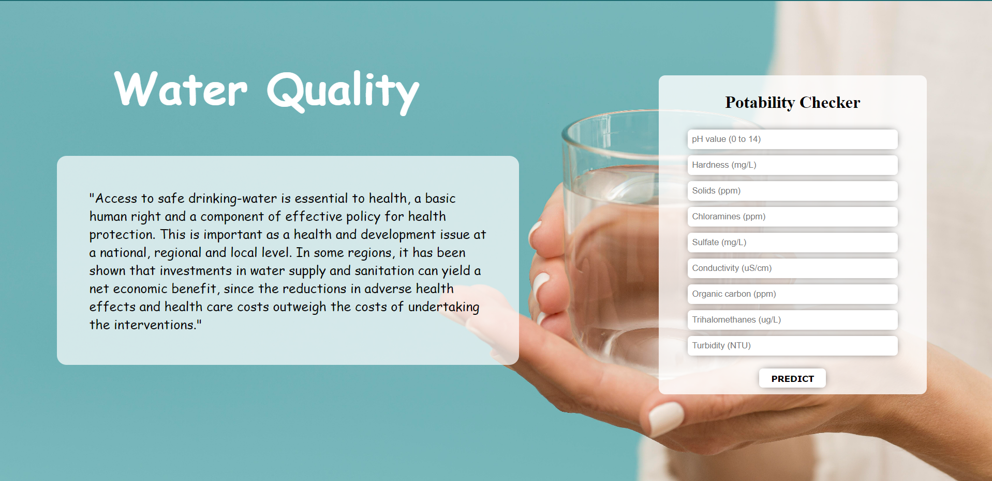
SCREENSHOTS

Slide 17
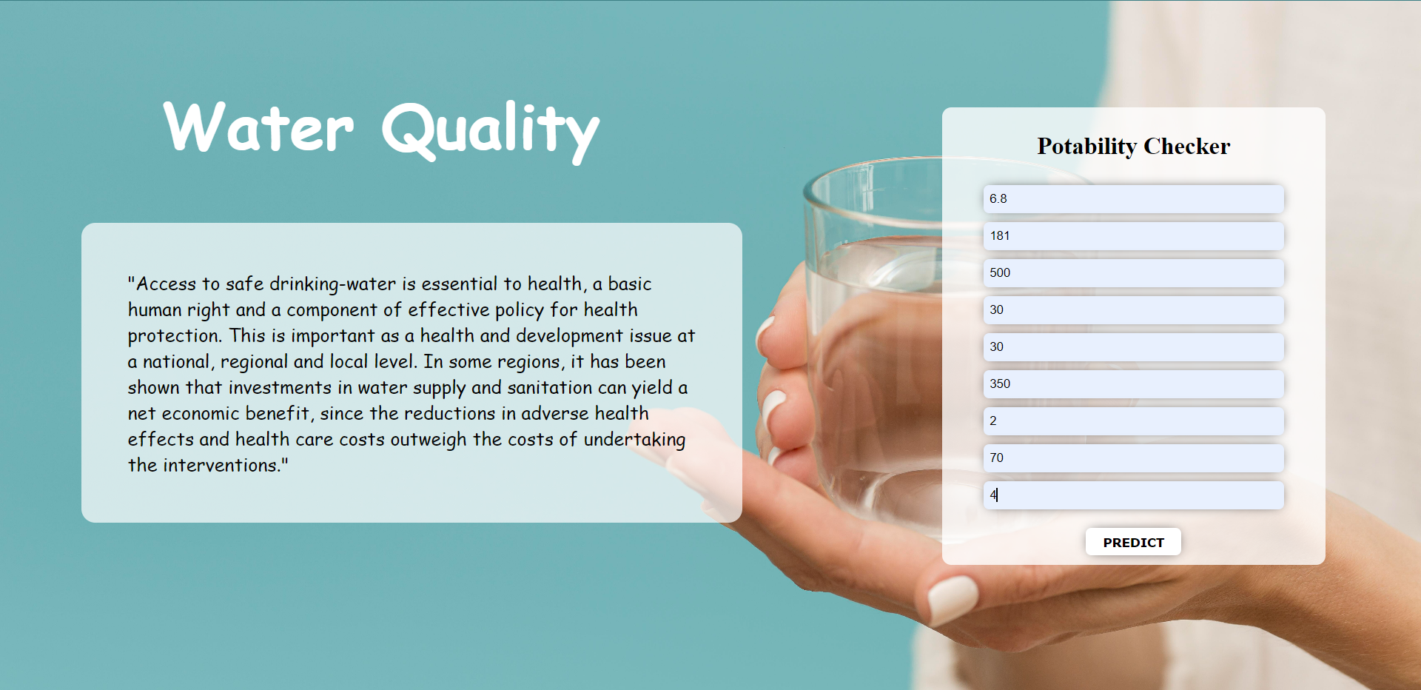

Slide 18
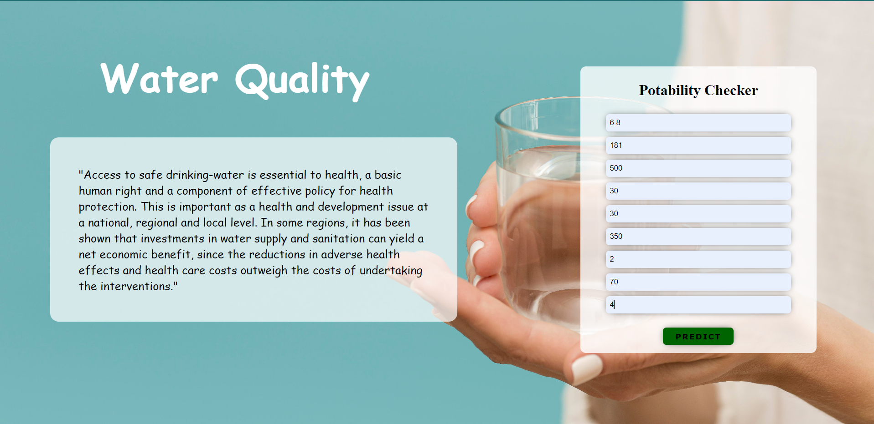

Slide 19


Slide 20
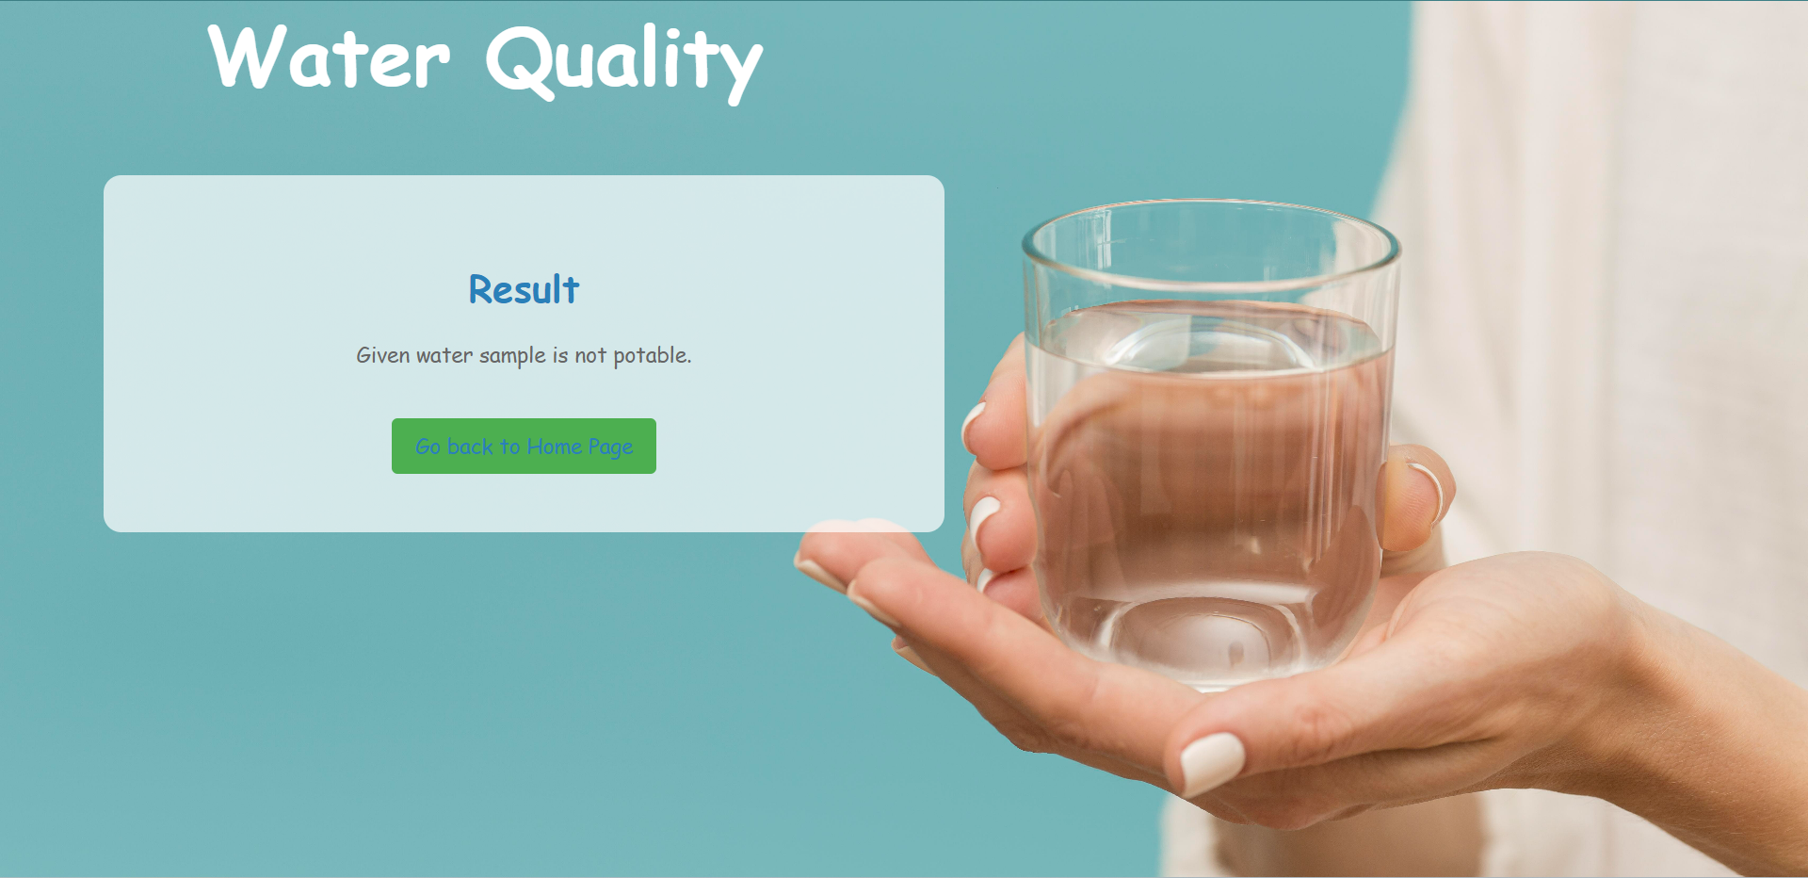

Slide 21
CONCLUSION
Water quality prediction systems are essential for ensuring the safety of our water supply.
These systems provide accurate and timely information on potential contaminants.
Advanced technologies and analytical tools are used to detect and prevent waterborne diseases.
Water quality prediction systems protect public health and promote environmental sustainability.
Investing in the development and implementation of these systems is crucial for community health and well-being.

Slide 22
FUTURE ENHANCEMENT
Integration with other water management systems for more comprehensive water management
Expansion of sensor capabilities to detect additional water quality parameters
Use of advanced machine learning techniques for improved accuracy and reliability of data
Cloud-based data storage and analysis for easier access and analysis of data
Predictive modeling to predict future water quality trends for proactive management

Slide 23
REFERENCES
L. Li et al., "Interpretable tree-based ensemble model for predicting beach water quality," Water Research, vol. 211, Mar. 2022, DOI: 10.1016/j.watres.2022.118078.
Hasriq Izzuan et al., “Water Quality Classification Using SVM And XGBoost Method ” 2022 IEEE 13th Control and System Graduate Research Colloquium (ICSGRC) July 2022
N. Nasir et al., “Water quality classification using machine learning algorithms,” Journal of Water Process Engineering, vol. 48, p. 102920, Aug. 2022, DOI: 10.1016/j.jwpe.2022.102920.

Slide 24
THANK YOU

